Slide 1
AI Use Case

Slide 2
CASE 1
Use AI to Generate CI/CD
By Claude AI

Slide 3
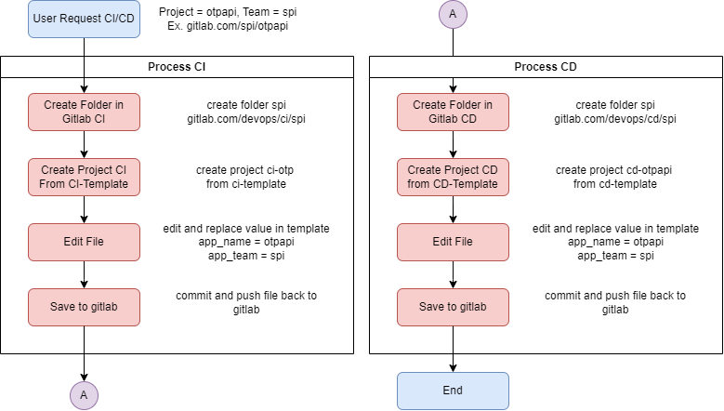

Slide 4
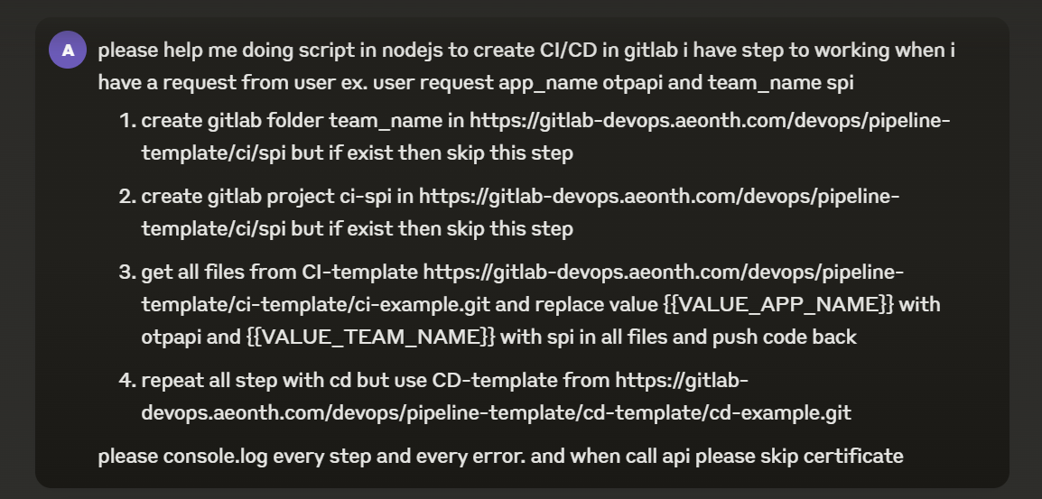

Slide 5
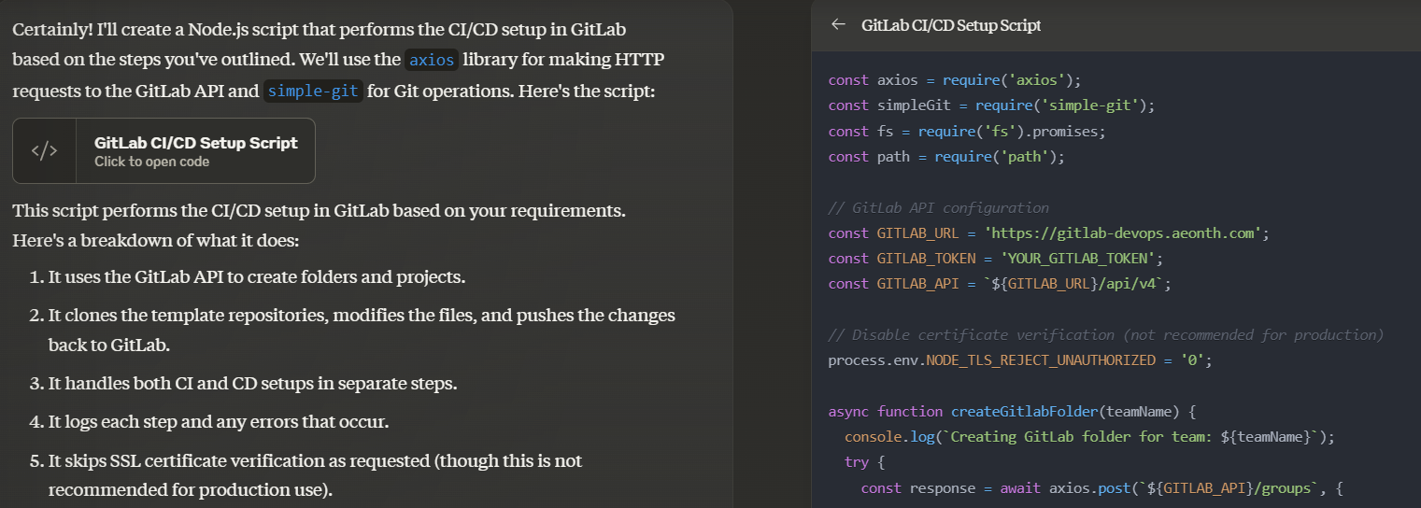

Slide 6
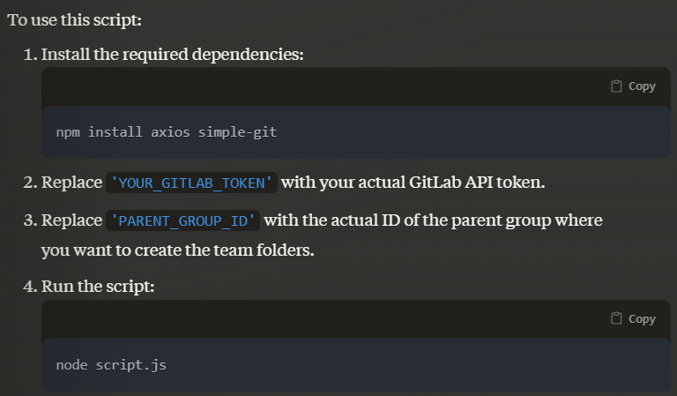

Slide 8
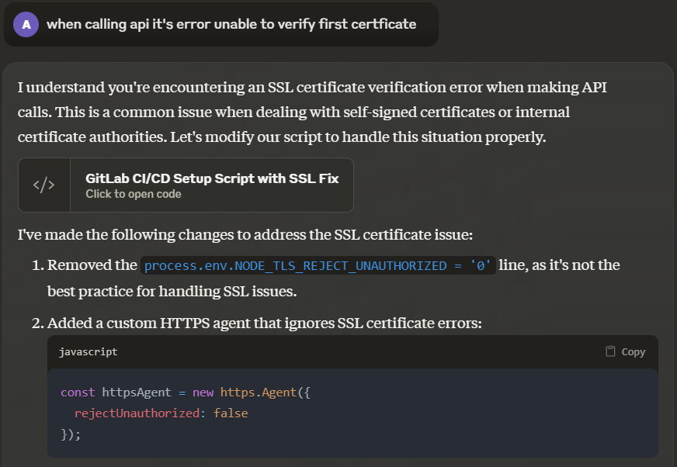

Slide 9
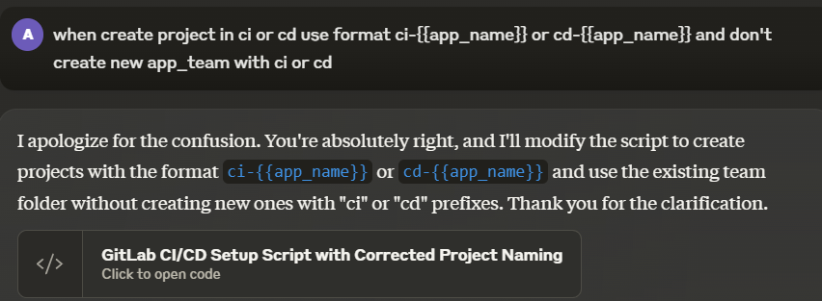

Slide 10
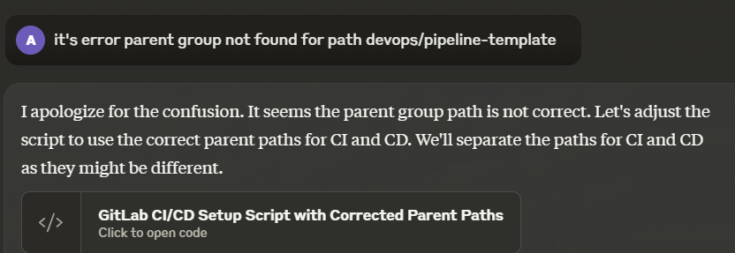

Slide 11
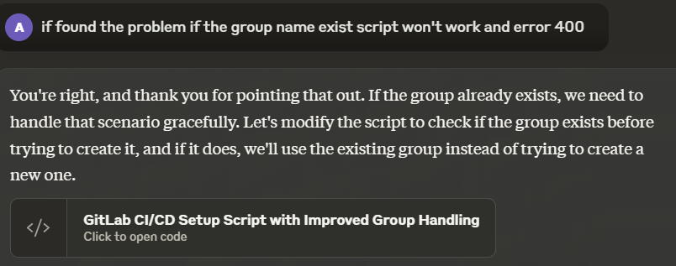

Slide 12
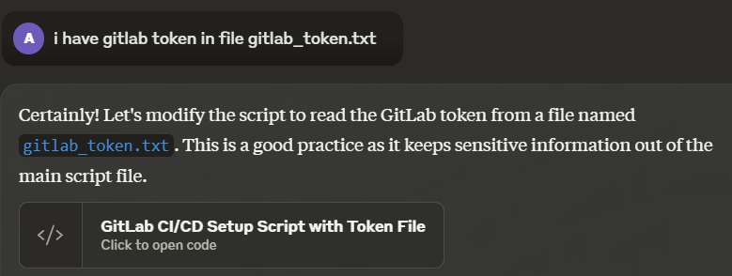

Slide 14
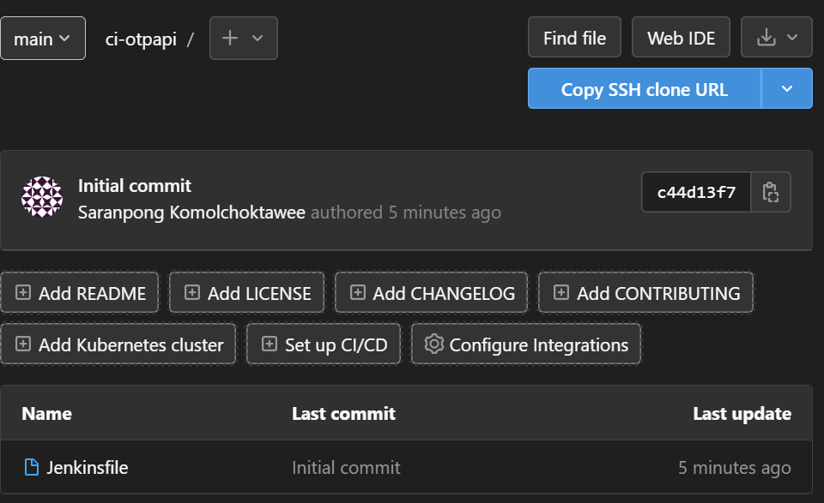
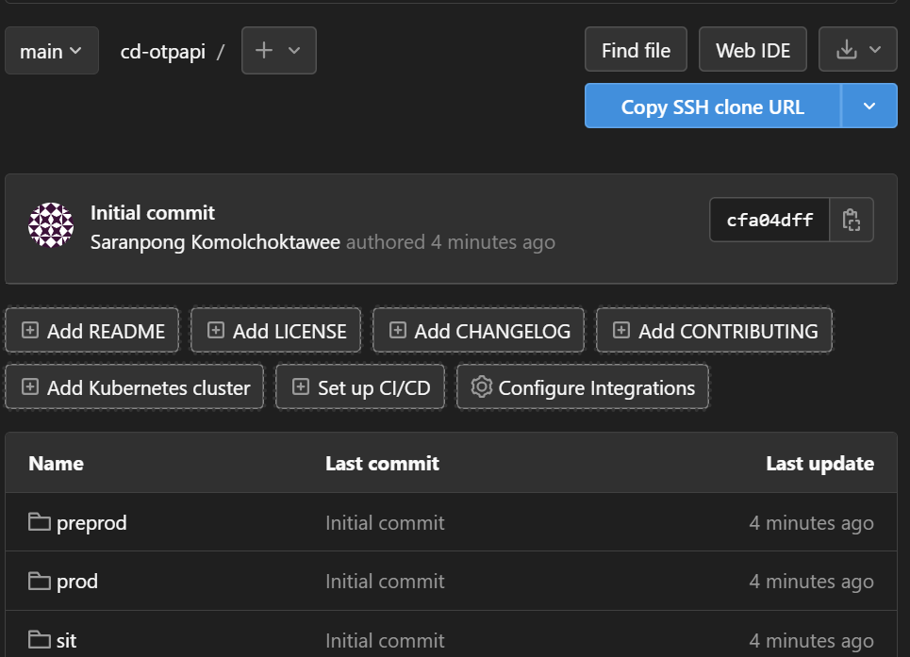

Slide 15
สรุป
Workflow
Use AI help your work
Improvement

Slide 16
CASE 2
Generate Report from Jenkins
By ChatGPT

